Slide 1
Introduction to Spark graph frames

Slide 2
Graph Processing on Apache Spark
Initially graph processing was done using the GraphX API. This provided a very effective API at the RDD level for processing graphs.
More recently Spark has introduced a new API for graphs called GraphFrames
GraphFrames extends GraphX to provide a DataFrame based API for graph processing.
GraphFrames is currently available as an external Spark package
However, in the future it maybe merged into the core of Spark.
GraphX and GraphFrames have about the same performance
However, GraphFrames is much easier to program.

Slide 3
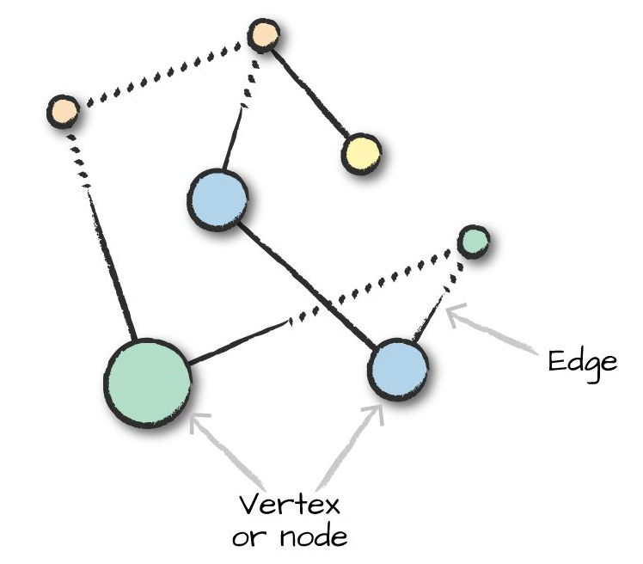
Types of graphs: Undirected graphs
In undirected graphs, the edges have no start and end vertex specified.

Slide 4
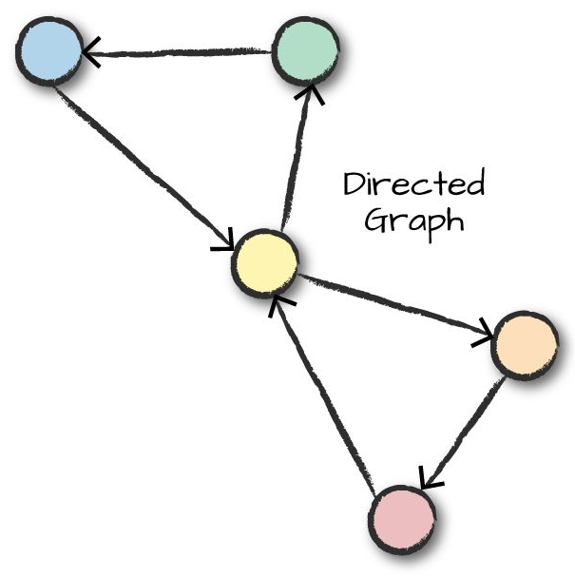
Types of graphs: directed graphs
In directed graphs each edge has a start and end vertex specified.

